Slide 1
Distributional Health Impacts of Electricity Imports in the United States
Eleanor Hennessy, Jacques de Chalendar, Sally Benson, and Inês Azevedo
Stanford University, Department of Energy Resources Engineering

Slide 2
Introduction
Exposure to air pollution can have significant health impacts [1], [2], and previous studies have shown that exposure to PM2.5 is responsible for thousands of deaths in the US each year [3].
Electricity production is a major contributor to PM2.5 production [3], [4].
Many regions in the US import significant amounts of electricity. As renewable energy penetration has increased, many Western Balancing Areas (BAs) in particular now import large amounts of power [5].
As the grid becomes more interconnected, it will be more important than ever to understand the effects of electricity imports on public health and carbon emissions.
Understanding these effects is essential to developing informed policies and regulations for the changing electric grid.

Slide 3
Objective
The primary goal of this work is to determine the effects of electricity imports in the US on health damages due to exposure to fine particulate matter (PM_{2.5}).
A secondary goal of this work is to understand the role of imports in CO₂ emissions in the US.
The final goal of this work is to trace the which balancing areas are responsible for both carbon emissions and PM_{2.5}-related health effects.

Slide 4

Methods: Model Overview
Model Inputs
Model Calculations
Model Outputs
Balancing Area-level Electricity Transfers Data
Hourly emissions from electricity imports and self-generation (electricity generated and consumed within a Balancing Area (BA))
Change in annual average PM2.5 concentration
Imports
Demand
Generation
Exports
Plant-level Emissions and Generation data
Increase in the number of premature mortalities
[6], [7]
Reduced Complexity Air Quality Model determines impact of emissions on PM2.5 concentrations
NO₂
CO₂
SO₂
PM_{2.5}
Plant Generation
Notes:
Add references for data sources

Slide 5



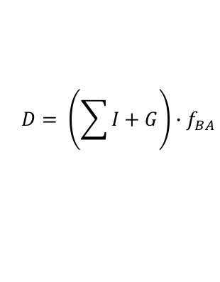
Methods: Responsibility for generation from imports and self-generation
Fraction of electricity consumed within BA:
$$f_{BA}= \frac{D}{D+X}$$
Electricity generated in BA₃ consumed in BA₁
$$D= \left(\sum{I}+G\right)∙f_{BA}$$
Total demand:
I: Imports
I_{3,1}
Electricity generated in BA₂ consumed in BA₁
Self-generation:
I_{2,1}
$$G∙f_{BA}$$
Electricity generated in BA₁ consumed within BA₁
Electricity generated in BA₁ exported to other BAs
Fraction of generation in BA_{i} being imported by BA_{j}:
D: Demand
$$f_{i,j}= \frac{I_{i,j}}{G_{i}}$$
We assume the fraction of generation from each plant in BA_{i} going towards self-generation is f_{BA}.
Likewise, we assume the fraction of generation from each plant in BA_{i} going towards imports in BA_{j} is f_{i,j}.
G: Generation
X: Exports

Slide 6
Conceptual Example

Slide 7

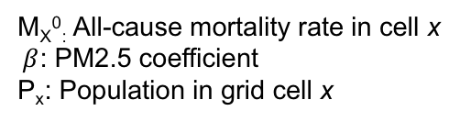



Methods: Calculating emissions and premature mortality
Emissions associated with self-generation:
E_{p}: Hourly emissions from power plant p
$$E_{SG}= f_{BA}∙E_{p}$$
Emissions associated with imports from BA_{i} to BA_{j}:
$$E_{i,j}= f_{i,j}∙E_{p}$$
Additional premature mortalities (∆M_{x}) in grid cell x resulting from an increase in annual average PM2.5 concentration of ∆PM_{2.5} due to self-generation or imports in BA_{i}
$${∆M}_{x}= M_{x}^{0}\left(e^{β∆PM2.5}−1\right)∙P_{x}$$
M_{X}⁰: All-cause mortality rate in cell x
$β$: PM2.5 coefficient
P_{x}: Population in grid cell x

Slide 8
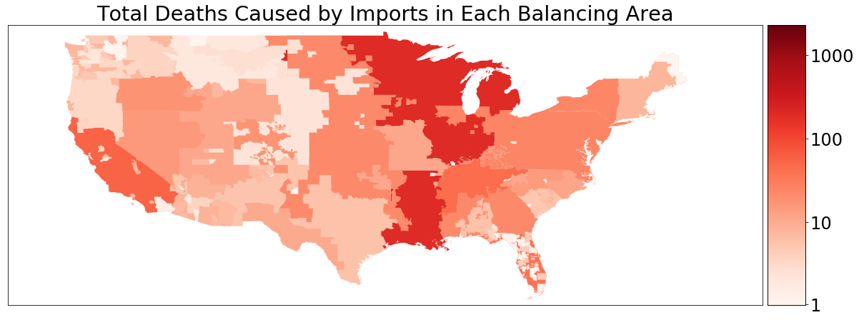
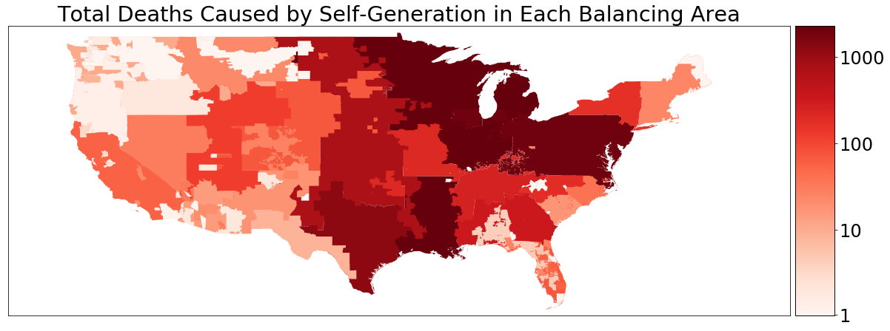
Results: Premature Mortalities
Overall, electricity consumption caused more than 9,000 mortalities in 2019
8% were caused by electricity imports
52% occur in a different balancing area than where electricity was consumed

Slide 9
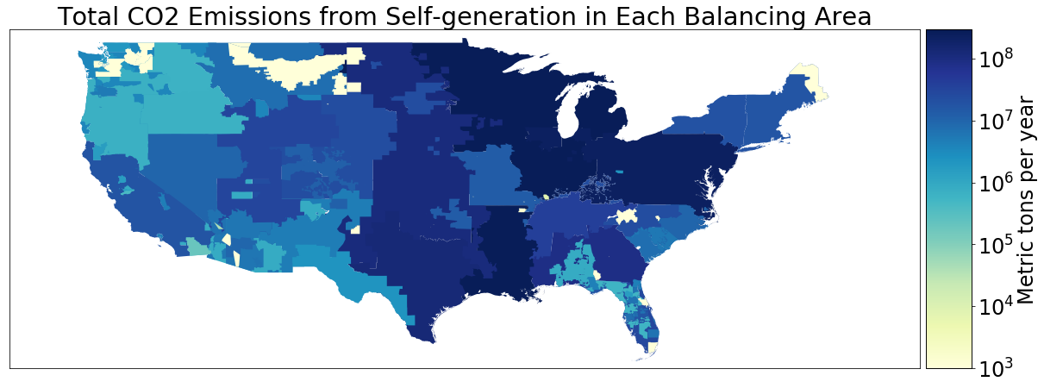
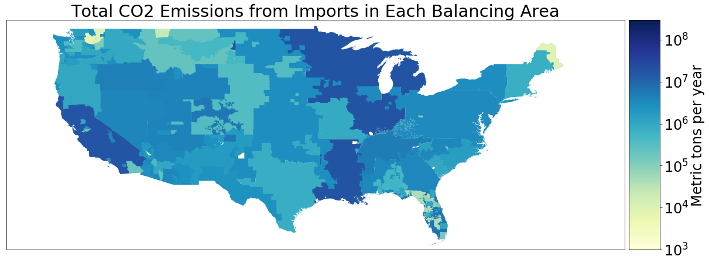
Results: CO₂ Emissions
9.5% of CO₂ emissions were caused by electricity imports
The BAs that cause the most health damages also cause the highest CO₂ emissions

Slide 10
Results: Environmental Justice
The most impacted counties tend to have disproportionately high Black and impoverished populations
Number of the ten counties experiencing the most damages with higher Black and impoverished populations than the state average
 | Imports (total deaths) | Self-generation (total deaths) | Imports (deaths/capita) | Self-generation (deaths/capita)
Larger % Black | 8/10 | 10/10 | 7/10 | 8/10
Larger % In Poverty | 5/10 | 6/10 | 7/10 | 9/10

Slide 11
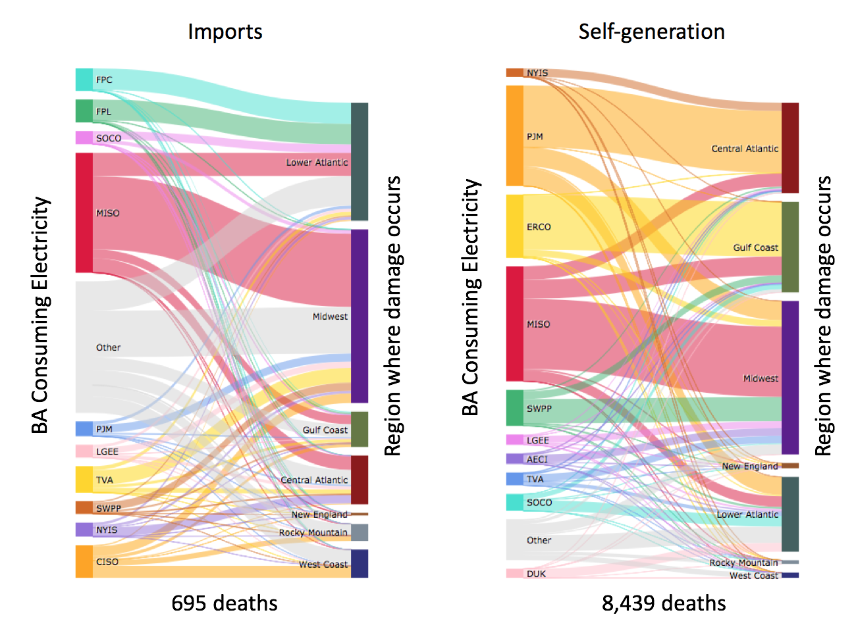
Results: Transfer of Damages
Some BAs such as Midcontinent Independent System Operator (MISO) and Florida Power and Light (FPL) primarily impact their own region
Others like California Independent System Operator (CISO) have impacts in multiple regions
MISO is the largest contributor to damages overall

Slide 12
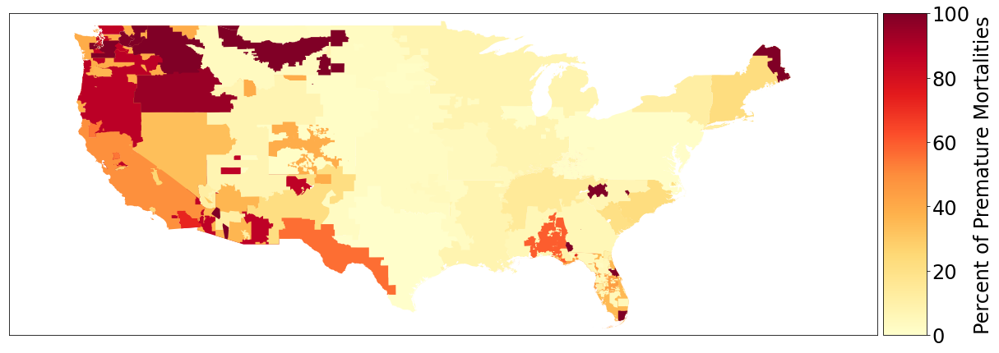
Results: Damages Caused by Imports
In Western BAs, imports cause the majority of health damages due to importing dirtier electricity than they generate

Slide 13
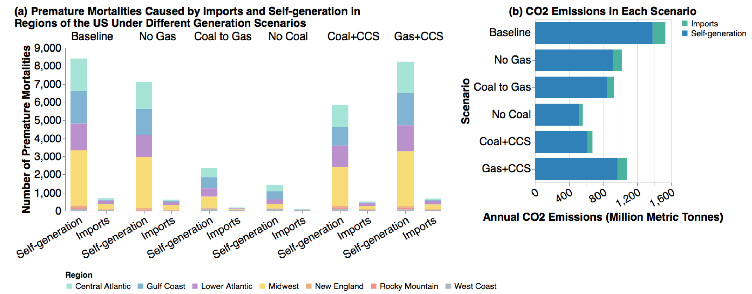
Results: Emissions Scenarios

Slide 14
Key Takeaways
In the Western United States, electricity imports are responsible for the majority of health damages related to electricity consumption
Similarly, significant CO2 emissions from Western BAs are caused by electricity imports
The most impacted counties are disproportionately Black and impoverished, raising environmental justice concerns
Replacing coal plants with zero emission sources is the most effective way to reduce both CO2 emissions and health damages
Policies on grid interconnection should strongly consider the regional impacts of electricity imports

Slide 15
Thank you!
Questions?

Slide 16
References
[1] C. Pope Arden, M. J. Thun, M. M. Namboodiri, D. W. Dockery, J. S. Evans, F. E. Speizer, and C. W.Heath, “Particulate Air Pollution as a Predictor of Mortality in a Prospective Study of U.S. Adults”,American Journal of Respiratory Critical Care Medicine, vol. 151, pp. 669–674, 1995.
[2] D. Dockery, C. A. Pope, X. Xu, J. Spengler, J. Ware, M. Fay, B. Ferris, and F. Speizer, “An Association Between Air Pollution and Mortality in Six U.S. Cities”,The New England Journal of Medicine,vol. 329, no. 24, 1993.
[3] I. C. Dedoussi, S. D. Eastham, E. Monier, and S. R. H. Barrett, “Premature mortality related to United States cross-state air pollution”, Nature, vol. 578, 2020.doi:10.1038/s41586-020-1983-8.[Online]. Available:https://doi.org/10.1038/s41586-020-1983-8.
[4] M. P. S. Thind, C. W. Tessum, L. Azevedo, and J. D. Marshall, “Fine Particulate Air Pollution from Electricity Generation in the US: Health Impacts by Race, Income, and Geography”, Environmental Science & Technology, vol. 53, pp. 14 010–14 019, 2019.doi:10.1021/acs.est.9b02527. [Online]. Available:https://pubs.acs.org/sharingguidelines.
[5] J. A. de Chalendar, J. Taggart, and S. M. Benson, “Tracking emissions in the US electricity system”, Proceedings of the National Academy of Sciences of the United States of America, vol. 116, no. 51,pp. 25 497–25 502, Dec. 2019,issn: 10916490.doi:10.1073/pnas.1912950116.
[6] A. L. Goodkind, C. W. Tessum, J. S. Coggins, J. D. Hill, and J. D. Marshall, “Fine-scale damage estimates of particulate matter air pollution reveal opportunities for location-specific mitigation of emissions”, Proceedings of the National Academy of Sciences of the United States of America, vol. 116,no. 18, pp. 8775–8780, Apr. 2019,issn: 10916490.doi:10.1073/pnas.1816102116.
[7] C. W. Tessum, J. D. Hill, and J. D. Marshall, “InMAP: A model for air pollution interventions”,PLOS ONE, vol. 12, no. 4, 2017.doi:10.1371/journal.pone.0176131. [Online]. Available:https://doi.org/10.1371/journal.pone.0176131.

