Slide 1
Investigating Transport and Structural Changes of Faults Slipping under sc-CO₂ Conditions in Shale
Talal Al Shafloot¹, Arjun Kohli¹, Tae Wook Kim¹, Anthony Kovscek¹
Nov 9th, 2021
¹ Energy Resources Engineering Department, Stanford University

Slide 2
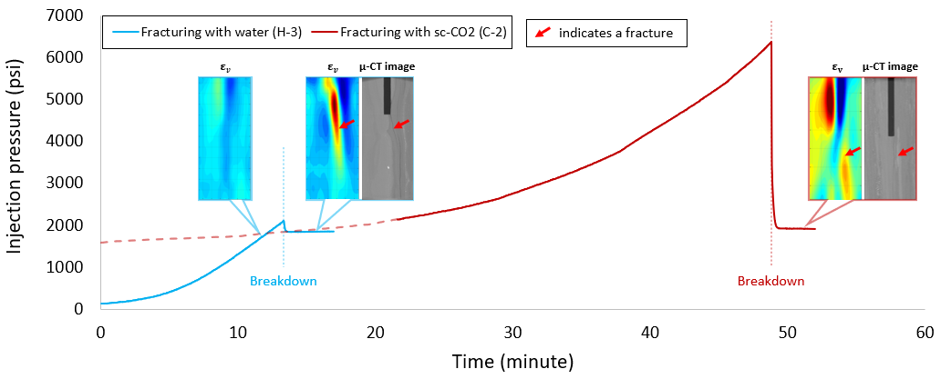
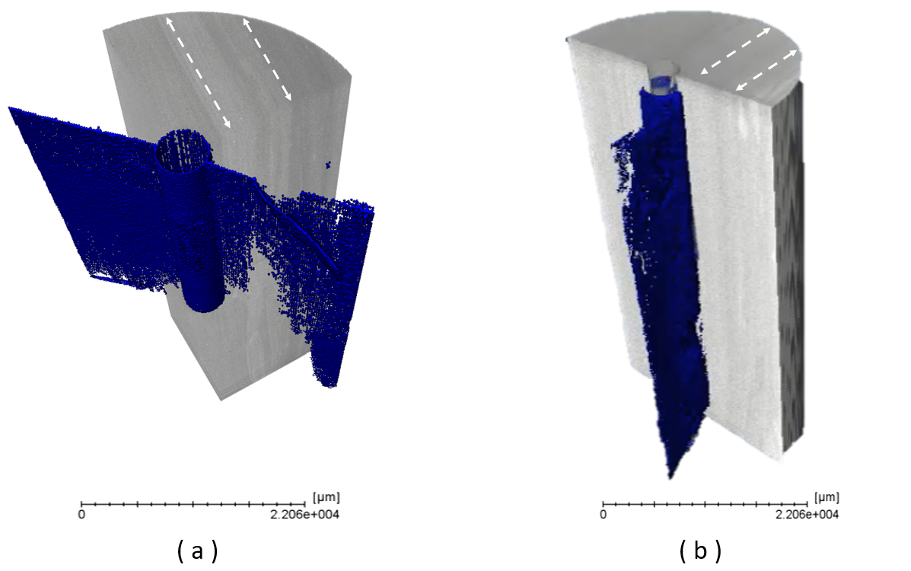
Problem
- Permeability evolution?
- Effect of slip on diffusion?
- sc-CO2 adsorption effect?
- sc-CO2 diffusion?
sc-CO₂
water
(Al Shafloot et al., 2020)
Modified after Fang et al., (2017)
Notes:
sc-CO2 stimulation agent, enhances productivity by: tensile fracturs or triggering pre-existing faults.
We investigated performance compared to water, utilized imaging techineques.
Triggering pre-existing, several questions with no clear answers.

Slide 3
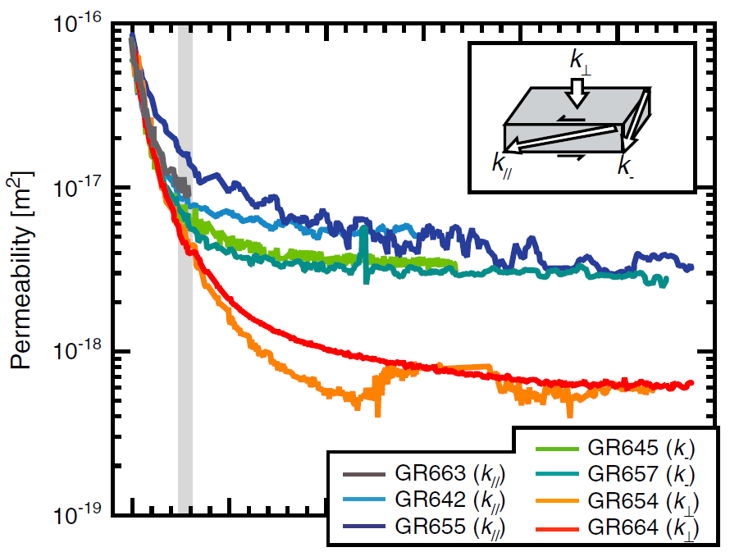
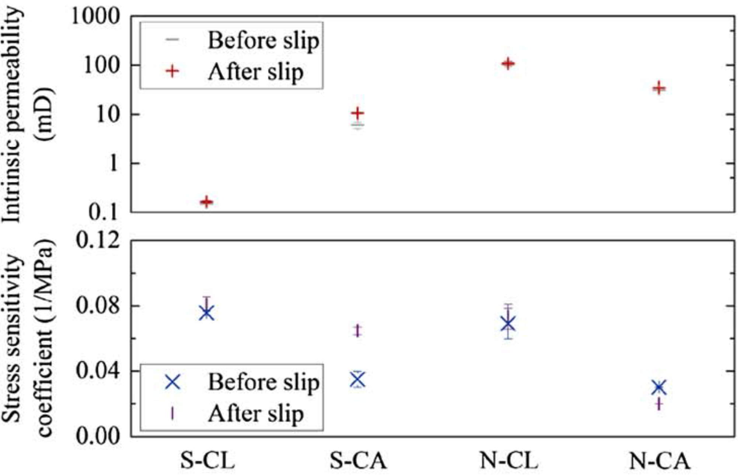
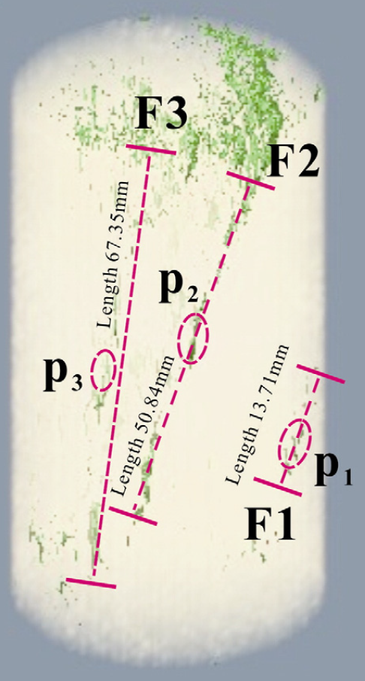
Background
Effect of slippage on permeability:
Gouge with water (Okazaki et al., 2013; Takahashi et al., 2007)
Saw-cut and natural fault with Argon (Wu et al., 2017)
Fracture/fault measuring permeability methods:
Pulse decay (Kumar et al., 2015)
Steady-state (Cai et al., 2014)
Pore pressure oscillation (Takahashi et al., 2007)
Utilizing X-ray CT for permeability investigation:
Fracture evolution of Coal samples (Cai et al., 2014)
(Okazake et al., 2013)
(Wu et al., 2017)
(Cai et al., 2014)
Notes:
-Okazaki, K., Katayama, I., & Noda, H. (2013). Shear‐induced permeability anisotropy of simulated serpentinite gouge produced by triaxial deformation experiments. Geophysical research letters, 40(7), 1290-1294.
-Takahashi, M., Mizoguchi, K., Kitamura, K., & Masuda, K. (2007). Effects of clay content on the frictional strength and fluid transport property of faults. Journal of Geophysical Research: Solid Earth, 112(B8).
-Wu, W., Reece, J. S., Gensterblum, Y., & Zoback, M. D. (2017). Permeability evolution of slowly slipping faults in shale reservoirs. Geophysical Research Letters, 44(22), 11-368.
-Kumar, H., Elsworth, D., Mathews, J. P., & Marone, C. (2016). Permeability evolution in sorbing media: analogies between organic‐rich shale and coal. Geofluids, 16(1), 43-55.
-Cai, Y., Liu, D., Mathews, J. P., Pan, Z., Elsworth, D., Yao, Y., ... & Guo, X. (2014). Permeability evolution in fractured coal—combining triaxial confinement with X-ray computed tomography, acoustic emission and ultrasonic techniques. International Journal of Coal Geology, 122, 91-104: investigated using microCT and fracture evolution of coal samples as a result of cyclic loading.

Slide 4
Goals
Motivation
Understand spatial and time scales of sc-CO₂ diffusion from active faults
Study effects of matrix composition and anisotropy
Study effects of fault slip and matrix damage on permeability
Objectives:
Visualize dynamics of diffusion in low permeability, layered media
Quantify permeability of fault plane before/after/during slip
Quantify impact of fault slip and damage on diffusivity
Notes:
Goals of trial tests:
Determining optimum experimental plan to accomplish goals.
Investigating possible imaging issues and confirming applicability.
Investigating feasibility to capturing diffusion dynamics across faults.
Determining suitable timing for experimental steps.

Slide 5
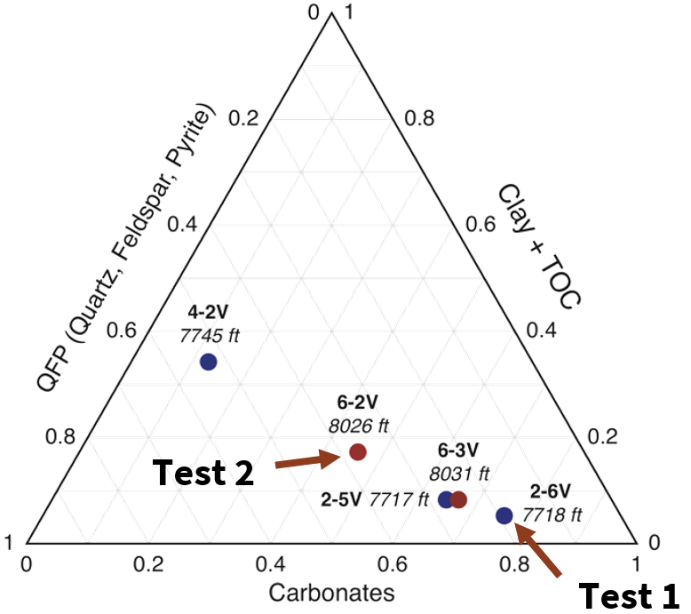
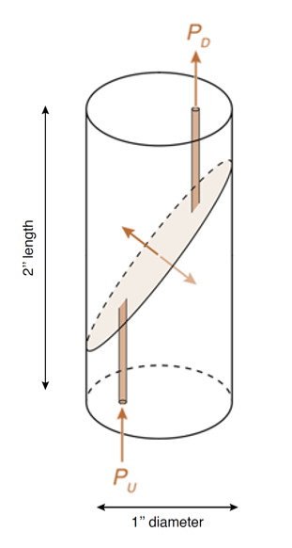
Experimental Work
Sample information
Sample preparation
 | Sample name | Formation
Test 1 | Z-2-6-V | Wolfcamp shale
Test 2 | Z-6-2-V | 0.978
Experimental workflow
Test 1
Test 2
Step | Objectives
µ-CT scanning (before and after) | Observe structural changes
Inject Kr | Quantify porosity Monitor diffusion
Inject CO₂ | Visualize Storage Capacity
Induce incremental slip | Quantify friction coefficient
Continue CO₂ injection | Investigate storage capacity increase
* Permeability is measured at different stages to monitor evolution

Slide 6
Experimental Setup
(Glatz et al., 2018)
Notes:
Talk about leakage and point it out
TALK ABOUT BOTH P AND T, THAT’S AN ADVANTAGE FOR YOUR WORK TO KEEP THE T AND P BOTH SIMILAR TO RESERVOIR CONDITION
CT scan of the main cell

Slide 7
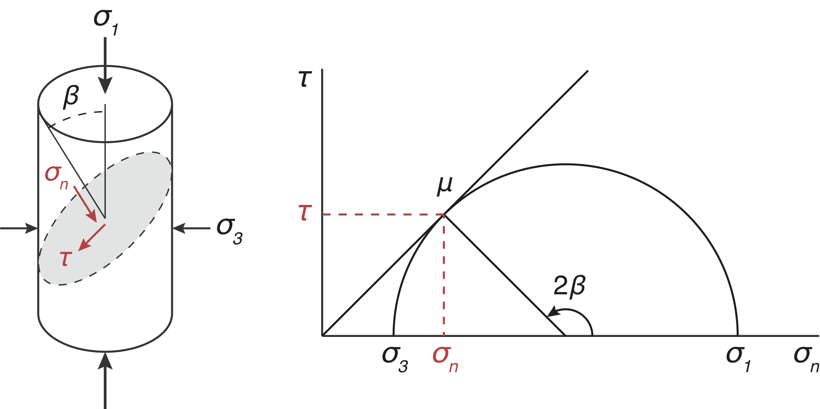
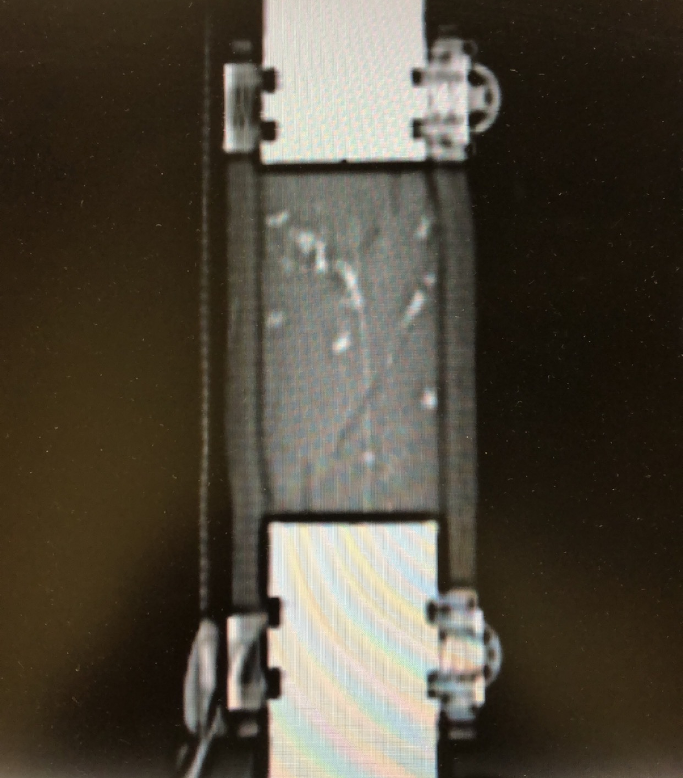
Results: Fault Slip
Resolved shear and normal stresses:
$τ= \frac{1}{2}(σ_{1}−$ $σ_{3})\sin{2β}$
$σ_{n}=$ $\frac{1}{2}\left[\left(σ_{1}+ σ_{3}\right)+\left(σ_{1}− σ_{3}\right)\cos{2β}\right]−P_{o}$
$Friction Coefficient=μ= \frac{τ}{σ_{n}}$
Summary
Test | Objective | Vertical displacement (mm)
1 | Pore pressure induced slip | 2.5
2 | Incremental axial load induced slip | 2.2
Notes:
Plots of n and B vs differential stress

Slide 8
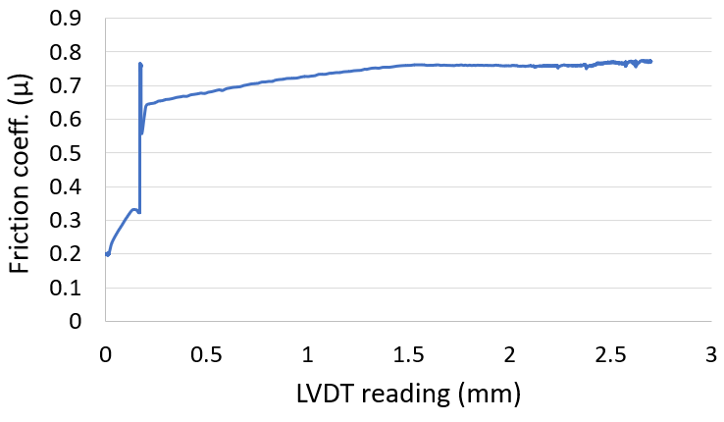
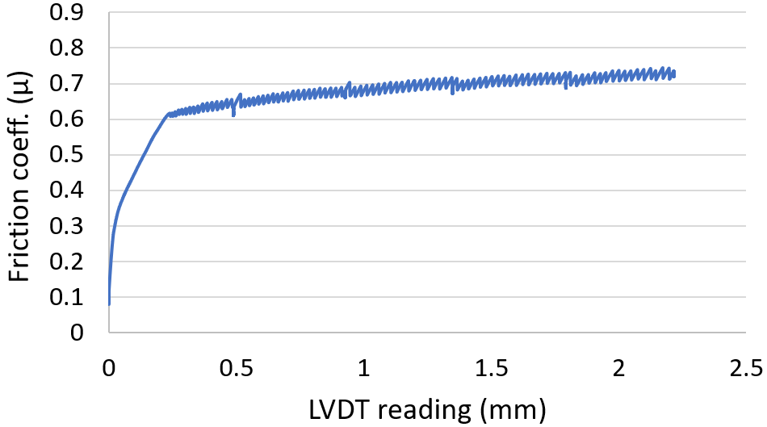
Results: Fault Slip
Pore pressure induced (test 1):
Fault slipped at µ = 0.57
Identified maximum vertical displacement
Axial loading induced (test 2):
Five slipping intervals
Fault slipped at µ = 0.61
Similar trend to work in literature
1300psi pore pressure applied

Slide 9
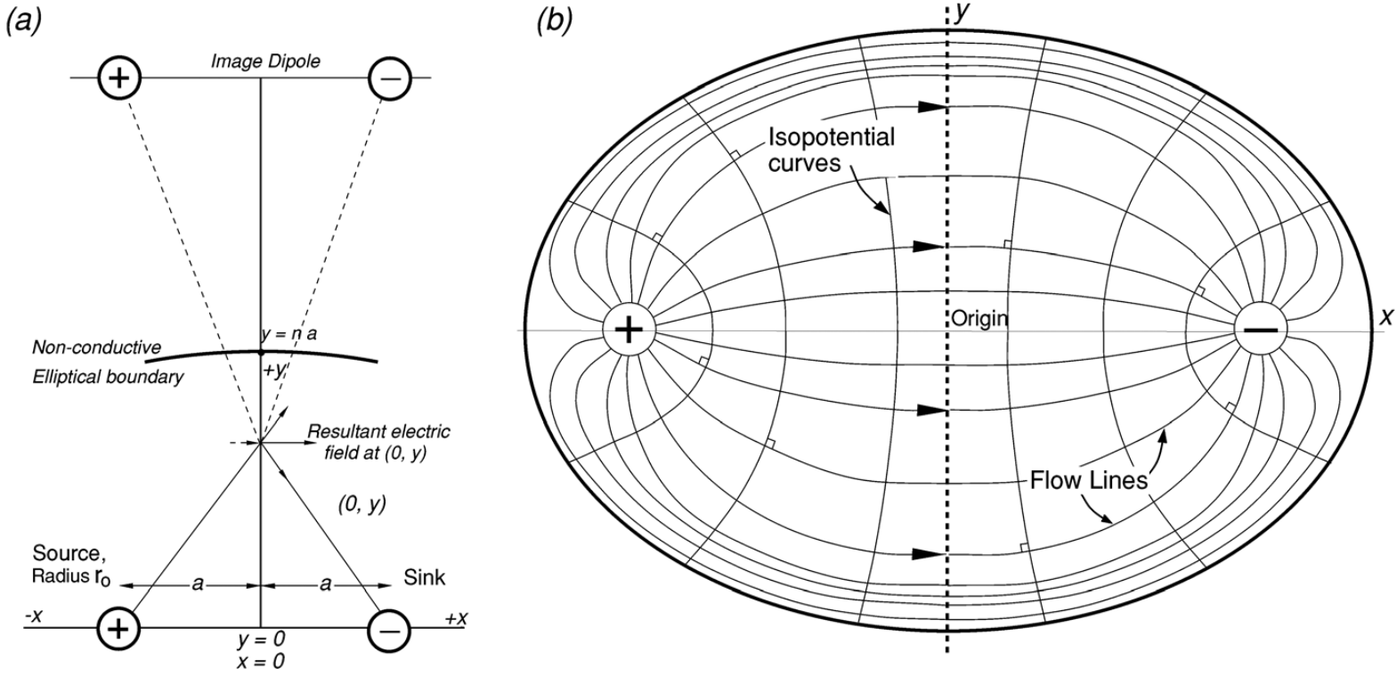
Results: Permeability Evolution
Steady state (Rutter et. al., 2018)
$$Q= \frac{dP kt}{μ} \frac{Bπ}{\log_{e}\left(\frac{2a}{r_{0}} −1)\right)}$$
$$B= \frac{2}{π}\tan^{−1}2n$$
Transmissivity (kt) has the dimension of M³
(a) Coordinate system for electric dipole (b) Nonconductive elliptical boundary to a conductive surface (Rutter et. al., 2018)
(a) Coordinate system)
Notes:
-flow of viscous fluid through a permeable matrix or through a more conductive crack are respectively analogous to the flow of electric current through a resistive solid or thorough a thin resistive sheet embedded within an insulating medium.
-not necessary to know the crack thickness.
-cmpare fluid transport capacity of the crack with that of flow through a matrics permeability km, given that permability is in effect the transmissivity of a meter thick layer of matrix material.

Slide 10
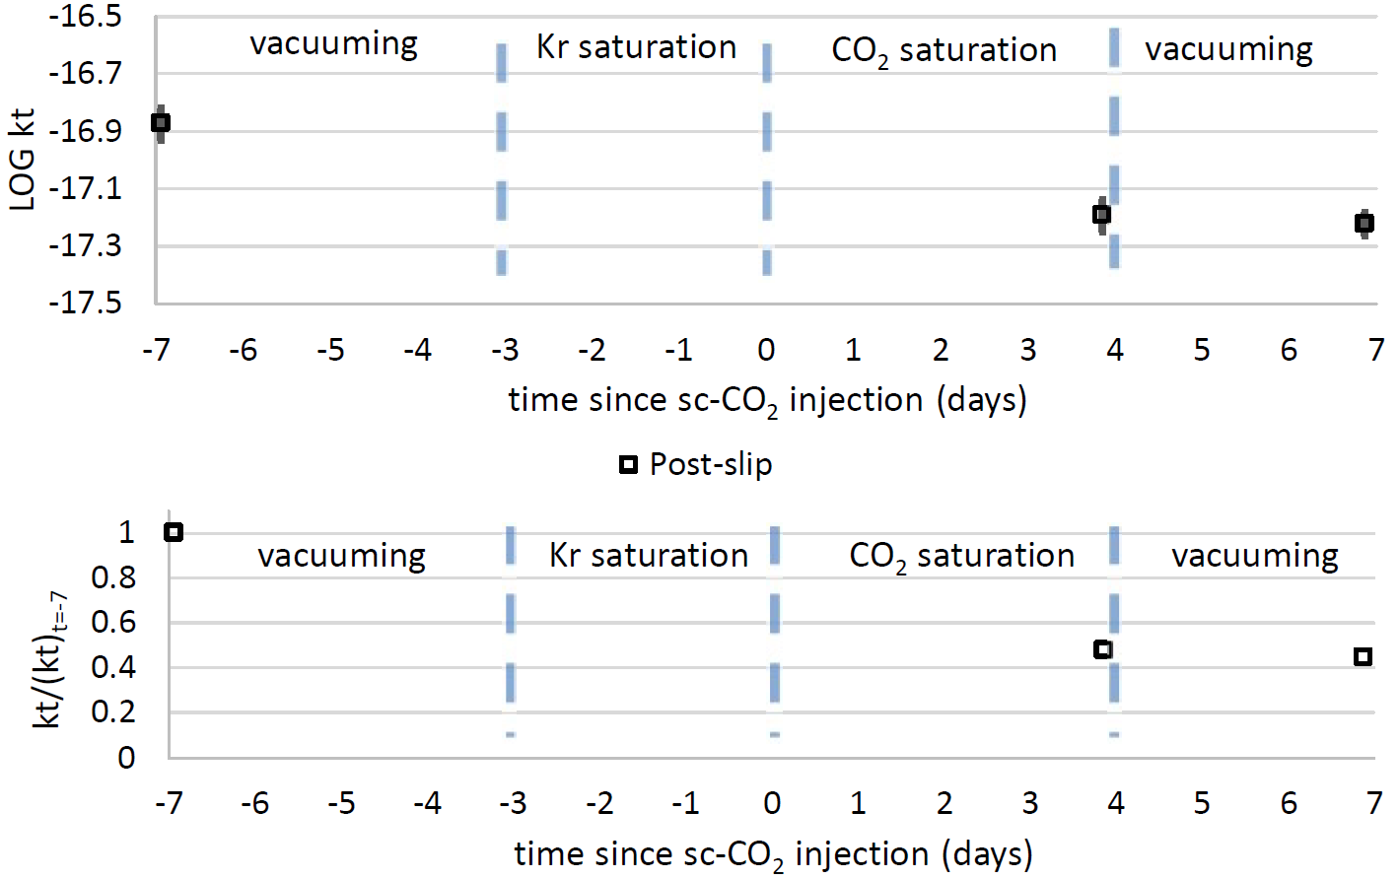
Results: Permeability Evolution
Saturation effect (test 1):
Saturating with Kr and CO₂ reduced fracture permeability by 52%
Vacuuming did not change permeability values: permeant damage

Slide 11
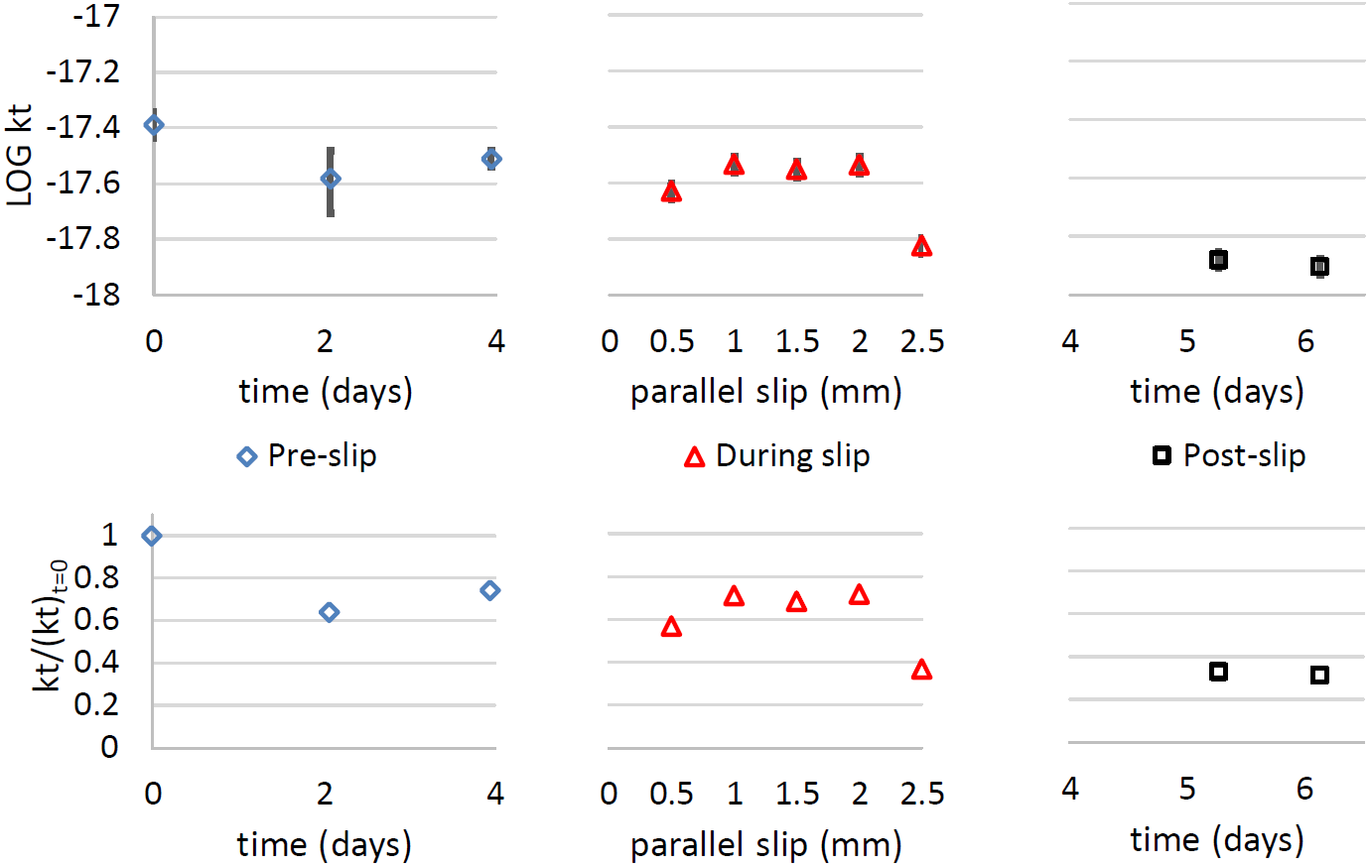
Results: Permeability Evolution
Slip effect (test 2):
Saturating with CO₂ reduced fracture permeability by 25%
Fault slippage further reduced permeability by an additional 29%
Relaxation after slip reduced permeability by an additional 8%

Slide 12
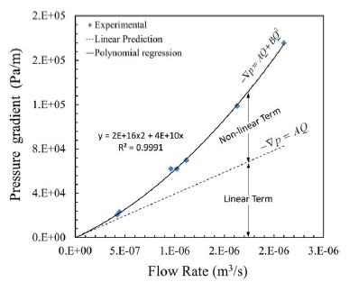
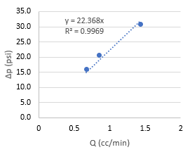
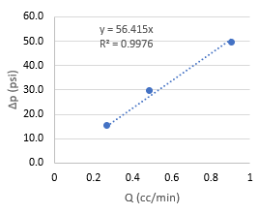
Results: Validating Steady-state
Flow inside borehole (test 2):
Maximum Re = 360
Laminar: Re < Re_{c} = 2000
Flow along fracture (test 2):
Re ranges from 20.5 to 47.9
Re_{c} in literature: 1 to 20
Large Re for fracture flow is acceptable:
Linear behavior for ∆p vs Q
Re_{c} in literature increases as fracture is smoother
2
1
Javadi et. al., 2014
Test 2: beginning of the injection (left) post slip (right)

Slide 13
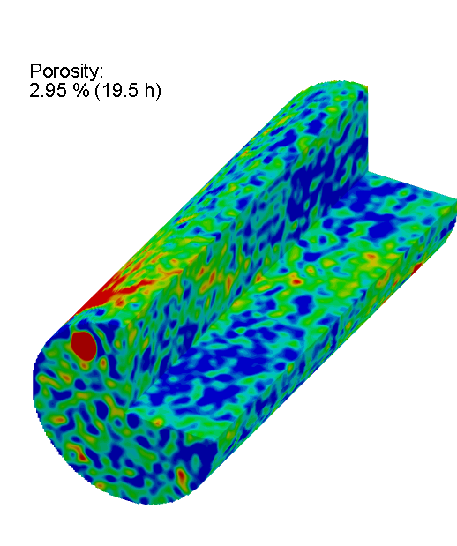
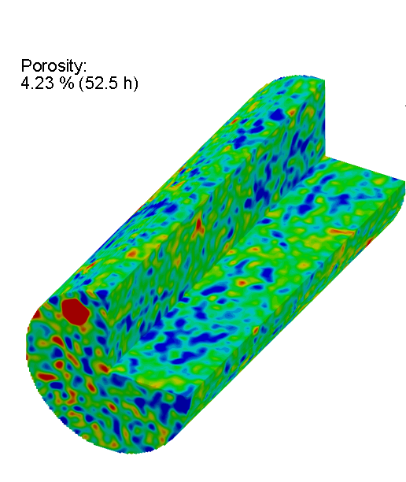
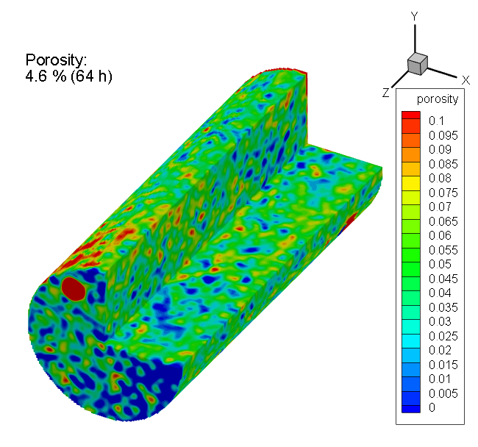
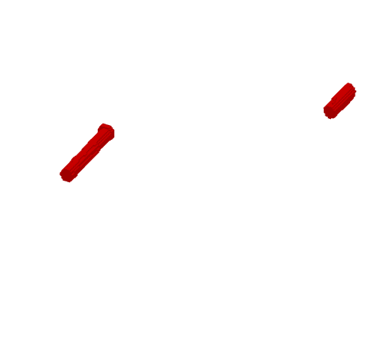
Results: Dynamic CT Imaging of Kr-filled Porosity
Saturating with Kr (test 2):
Porosity distribution helps visualizing diffusion
Visualization confirms diffusion around fault vicinity
borehole
2.5 hrs
52 hrs
64 hrs
car
car
car

Slide 14
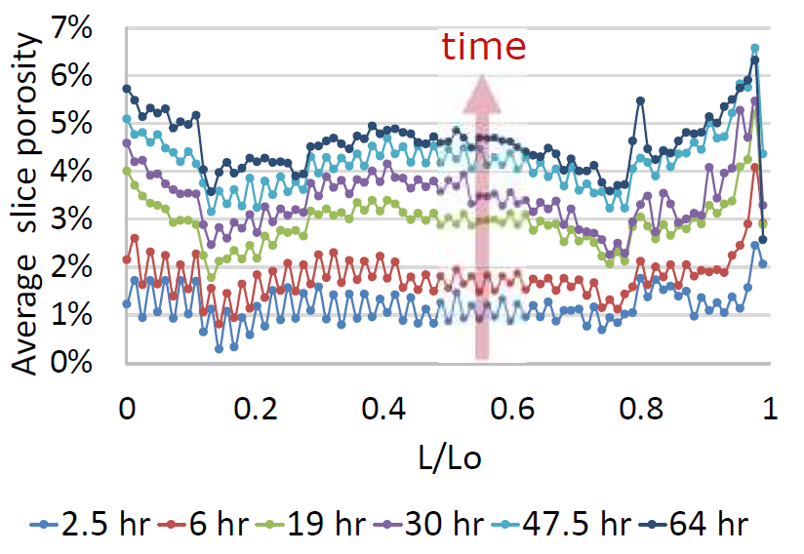
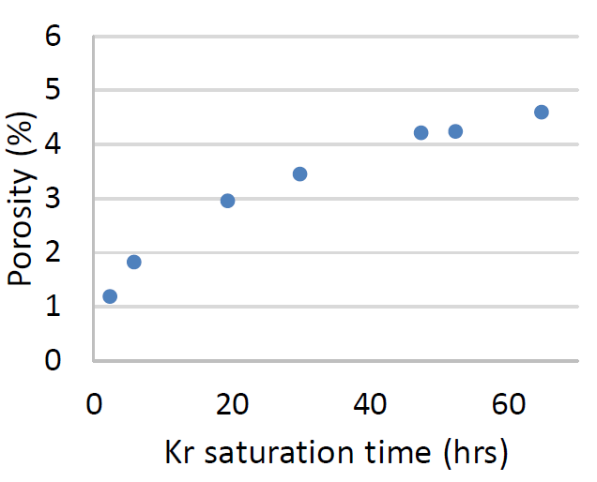
Results: Dynamic CT Imaging of Kr-filled Porosity
Saturating with Kr (test 2):
Wolfcamp samples have small porosity
Longer saturation time is needed

Slide 15
Summary
Faults were successfully slipped with both pore pressure and incremental axial loading. Estimation of jacketing resistance is needed to quantify µ.
Steady-state approach was utilized and validated to measure fracture permeability.
Saturating with fluids with large adsorption capacity reduces permeability. Saturating with sc-CO2 decreased fracture permeability by at least 25%.
Slipping a smooth fault considerably reduced fault permeability.
CT Imaging helped visualizing diffusion of fluids and quantifying porosity.

Slide 16
Acknowledgment
King Fahd University of Petroleum and Minerals (KFUPM)
Saudi Arabian Cultural Mission (SACM)
Natural Gas Initiative (NGI)
Stanford Center for Carbon Storage (SCCS)
This work was supported as part of the Center for Mechanistic Control of Unconventional Formations (CMC-UF), an Energy Frontier Research Center funded by the U.S. Department of Energy, Office of Science under DOE (BES) Award DE-SC0019165

Slide 17
Thank You!

